Slide 1







COLOSSEUM HACKATHON
Agent1c.ai
The web-based Solana OS with an AI agent inside.
A desktop on the web where Solana dapps become native app panels, wallet context becomes workspace context, and Hitomi helps users operate across it.
Dapp launcher
AI compute
Wallet context
hi, i'm Hitomi (^_^)
let's make Solana feel like an OS.
Launch goal: make Agent1c the first tab serious Solana users open.
Agent1c.ai | Colosseum Solana Hackathon Pitch
1

Slide 2
PROBLEM
Solana UX is fast, but the workspace is fragmented.
Power users still run their onchain life from scattered tabs, dashboards, chats, and notes.
Current session
- Wallets are great for signing, but weak at memory, context, and orchestration.
- Dapps are excellent in their own silo, but users operate across many protocols.
- AI lives in a separate tab, so it rarely sees the user's actual workspace.
- DePIN operators and DeFi users both need a command surface, not another bookmark list.
wallet + explorer + app + chat + notes + analytics
User feeling
too many tabs, too little memory (>_<)
Opportunity
own the home surface where Solana work actually happens
Agent1c.ai | Colosseum Solana Hackathon Pitch
2

Slide 3
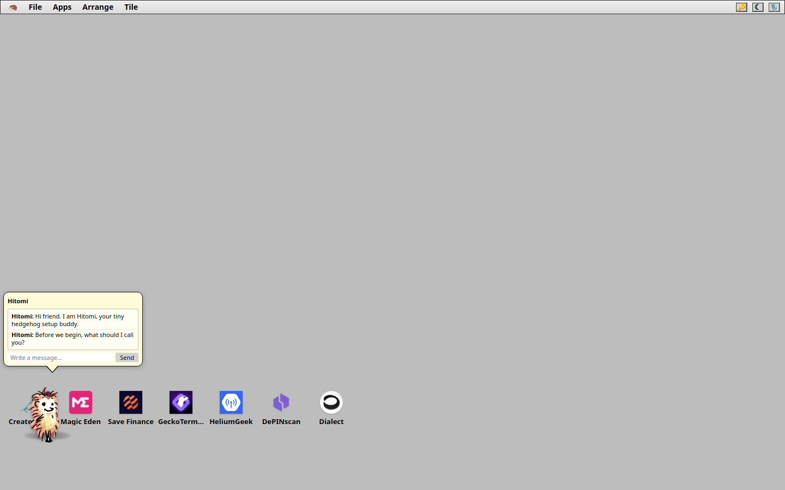
SOLUTION
Agent1c.ai turns the browser into a Solana desktop.
Dapps launch as windows. The agent lives inside the workspace. Context can persist across sessions.
1
2
3
Open Agent1c.ai in any browser.
Launch Solana apps as desktop panels.
Let Hitomi reason over the workspace.
Agent1c.ai | Colosseum Solana Hackathon Pitch
3

Slide 4
LIVE DAPP LAUNCHER
Solana dapps now behave like native HedgeyOS apps.
The fastest product wedge is simple: iframe-friendly dapps become desktop icons and app panels.
Magic Eden
Save Finance
GeckoTerminal
HeliumGeek
DePINscan
Dialect
iframe panel
iframe panel
iframe panel
iframe panel
iframe panel
iframe panel
This makes Agent1c a distribution surface for Solana apps, not just another AI chat interface.
Agent1c.ai | Colosseum Solana Hackathon Pitch
4

Slide 5
AI COMPANION
Hitomi is the agent inside the OS.
The assistant is not bolted onto the side; she sits inside the same desktop where the user works.
Workspace context
Windows, notes, files, app state, and wallet context can become prompt context.
i can remember the workspace,
open tools, and explain what changed. o7
Tool execution
Hitomi can route through explicit tools instead of guessing what happened.
Delight layer
The hedgehog and emoticon style make the OS memorable without hiding the serious workflow.
Agent1c.ai | Colosseum Solana Hackathon Pitch
5

Slide 6
SOLANA STATUS
The current integration is real and deliberately read-only.
That gives judges something testable now while keeping transaction risk out of the demo.
Wallet auth
Wallet reads
Hitomi tools
Dapp apps
Solana wallet detection and Supabase Web3 sign-in path.
RPC balance, recent signatures, and parsed transaction summaries.
Wallet overview and refresh tools return structured read-only context.
Six iframe-friendly Solana dapps are already in the desktop.
Important demo rule: no signing, sending, swaps, custody, or private key access in the current build.
Agent1c.ai | Colosseum Solana Hackathon Pitch
6

Slide 7
WORKFLOWS
The OS framing works for DeFi and DePIN.
Both categories need continuity, memory, and an operator surface.
DeFi power user
DePIN operator
Open NFT markets, lending, charts, notes, and wallet context in one session. Hitomi summarizes what changed and helps route the next action.
Keep maps, rewards, uptime dashboards, device notes, and alerts in one cloud workspace. The agent becomes the operations companion.
(*_*) fewer tabs -> better decisions -> more sessions
Agent1c.ai | Colosseum Solana Hackathon Pitch
7

Slide 8
WHY NOW
AI compute and Solana composability create the opening.
The winning product is the one that owns the workspace, not a single isolated action.
Browsers are ready
Dapps are ready
Agents are ready
A full web desktop can be distributed instantly through GitHub Pages and any modern browser.
Iframe-friendly apps let us expand the operating surface immediately.
The useful AI interface is contextual, persistent, and tool-driven.
Agent1c is positioned as the connective tissue between all three.
Agent1c.ai | Colosseum Solana Hackathon Pitch
8

Slide 9
BUSINESS MODEL
Agent1c monetizes AI compute and premium workspace access.
The model starts simple, then becomes more Solana-native as the community grows.
1. Credits
2. Subscription
3. Dapp surface
Users buy AI compute credits for Hitomi and higher-volume agent sessions.
Monthly plans unlock larger compute buckets, saved workspaces, and premium OS features.
Featured dapp placement, partner launchers, and workflow templates as distribution grows.
Agent1c.ai | Colosseum Solana Hackathon Pitch
9

Slide 10
WINNER COMMITMENT
If we win, we will launch token-staked AI compute access.
The promise: stake the Agent1c utility token to unlock free AI compute allowance while the stake remains locked.
Stake
Unlock
Use
Lock Agent1c utility tokens for a chosen period.
->
Receive a recurring AI compute allowance without card payment.
->
Spend allowance on Hitomi, tools, and premium workspace actions.
This is a utility access model: no APY promise, no passive income claim, final token terms subject to legal and compliance review.
Agent1c.ai | Colosseum Solana Hackathon Pitch
10

Slide 11
ROADMAP
A tight path from hackathon demo to launchable product.
Each phase makes the OS more useful without taking custody or hiding risk.
Now
30 days
60 days
Winner path
Remote-testable web desktop, Hitomi, Solana auth, wallet reads, and six dapp panels.
More iframe-safe dapps, better launcher metadata, workspace templates, and wallet summary UI.
Agent workflows for research, notes, monitoring, DePIN operations, and dapp routing.
Launch token-staked compute access MVP and start community distribution.
Agent1c.ai | Colosseum Solana Hackathon Pitch
11

Slide 12
POSITIONING
Agent1c is not competing as one more dapp.
It combines the surfaces users already need into one persistent command environment.
Wallets
Dashboards
Dapp directories
Generic agents
Strong signing, weak workspace memory.
Strong visibility, weak orchestration.
Strong discovery, weak continuity.
Strong chat, weak onchain workspace.
Agent1c: wallet-native context + dapp panels + AI companion + persistent desktop.
Agent1c.ai | Colosseum Solana Hackathon Pitch
12

Slide 13
HACKATHON ASK
Help us turn Agent1c into Solana's AI workspace.
We are using the hackathon to validate the OS category and accelerate distribution.
Judges
Dapp teams
Community
Evaluate the product as a new home surface for Solana activity, not only as a wallet feature.
Give us iframe-safe routes, metadata, and workflows that should become native panels.
Test the desktop, request apps, and shape the staking-for-compute launch model.
Winning unlocks the public token-staked compute access milestone.
Agent1c.ai | Colosseum Solana Hackathon Pitch
13

Slide 14

CLOSE
Make Agent1c the first tab for Solana.
A web OS, a dapp launcher, an AI companion, and a community-native compute model.
agent1c.ai
The Solana OS with Hitomi inside (^_^)
ship the OS.
win the hackathon.
stake for compute. o7
Agent1c.ai | Colosseum Solana Hackathon Pitch
14

